Slide 1
Fit – Part 1

Slide 2
Intro to Fit
Framework for integrated tests
The need for Fit
Users themselves have a hard time expressing their desires for a system or feature
Developers don't understand what the customer wants
Delivered software is perceived as low quality
Software is difficult to maintain and "breaks" easily
Fit strengths
Communication: Concrete way to express expected software functionality
Perspective: Automation from a business point of view

Slide 3
Fit focus
Business rules – calculations, decisions and their criteria, limits, minimums, etc
Business process – workflows or steps in a process, approvals, denials, etc

Slide 4
Value of Fit tables
Communication – Specific example driven expectations clarify communication
Agility – Automated tests provide confidence to implement changes
Balance – Reduce problems by catching them early, fixing them and making sure they don't reappear later

Slide 5
Who is Fit for?
Business people – the folks who want or at least will use the new features
Business analysts – a tool to make requirements concrete and testable for both customers and developers
Managers – improved communication between customers and the technical team improves moral and productivity
Testers – create tests from the begining in terms the users understand
Developers – Increased understanding of the problem; more confidence that your changes didn't break anything

Slide 6
Intro to Fit tables
Using a table based approach is low tech
Less intimidating to business people
It is clear so developers know what outcomes to produce
In short, tables are the key to facilitating communication in Fit

Slide 7
Generalization from specifics
Fit's table based approach provides a collection of specific examples
Once we see the range of possible expected outcomes
We can make a general rule
We have specific cases to test with

Slide 8
The two types of Fit tests
Calculations
How to calculate a discount
Determine if a payment request should be made
Business processes
Steps to admit a patient to a hospital
Approval of a reimbursement request

Slide 9
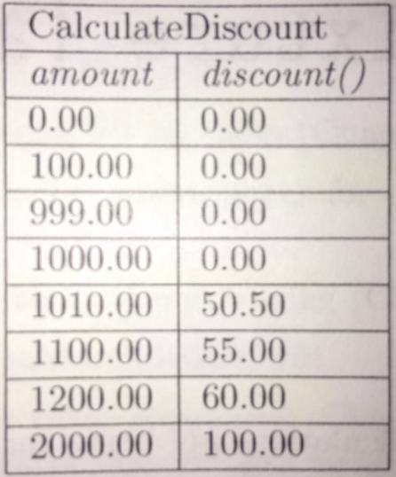
Fit table structure
Input
Expected output

Slide 10
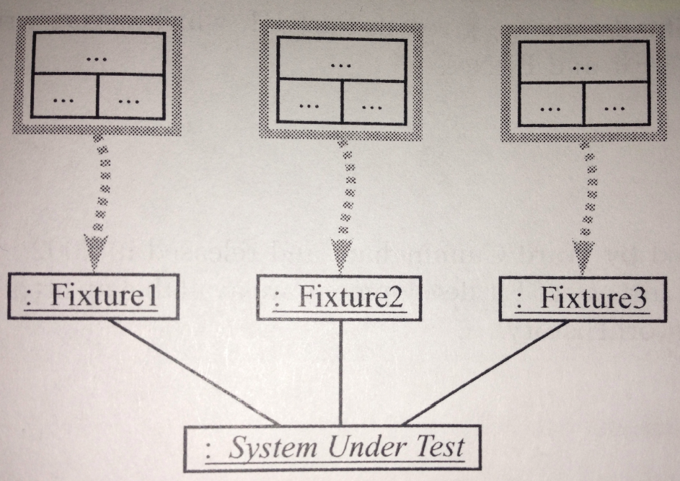
Fit architecture overview
User defined tables

Slide 11
Fit architecture overview
User defined tables
Programmer defined mapping

Slide 12
Fit architecture overview
User defined tables
Programmer defined mapping
SUT

Slide 13
The three Fit table types
ColumnFixture
Used to do calculation testing
ActionFixture
Used to test that a sequence of actions have the desired effect
RowFixture
Used to test results of a search or query
Verify the contents of a list or collection

Slide 14
ColumnFixture Example 1
Business rule
A 5 percent discount is provided whenever the total purchase is greater than $1,000

Slide 15
Reading a ColumFixture table
Fixture
given column name
calculated column name
test rows

Slide 16
Results coloring
Each test row will receive a color after test execution
Green: Test passed
Red: Test failed
Yellow: Test not finished – something wrong
Gray: Not processed

Slide 17
ColumnFixture Example 2
Business rule
Credit is allowed up to an amount of $1,000 for a customer who has been trading with us for more than 12 months, has paid reliably over that period and has a balance owing less than $6,000

Slide 18
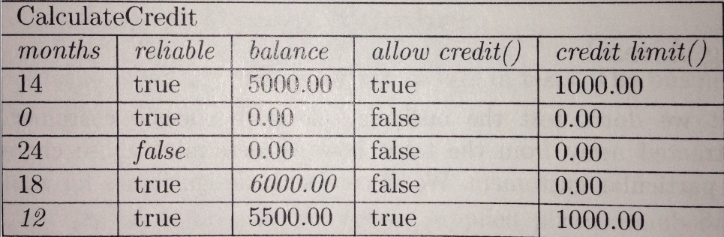
ColumnFixture table
Fixture
the "given" columns
the "calculated" columns
test rows

Slide 19
ColumnFixture Summary
Fit tests are defined in tables
ColumnFixture tables are good for specifying the expected calculated value based on the given value(s) in a row
The test writer gets to choose the names and values
When Fit runs it produces a color coded report

